Slide 1

Chord-based User Service
ÁLVARO ALBERO GRAN
TYLER JONES
SEAN McBride
Naim Merheb
CSCI 6421 Distributed Systems
Prof. Roozbeh Haghnazar Koochaksaraei
George Washington University

Slide 2
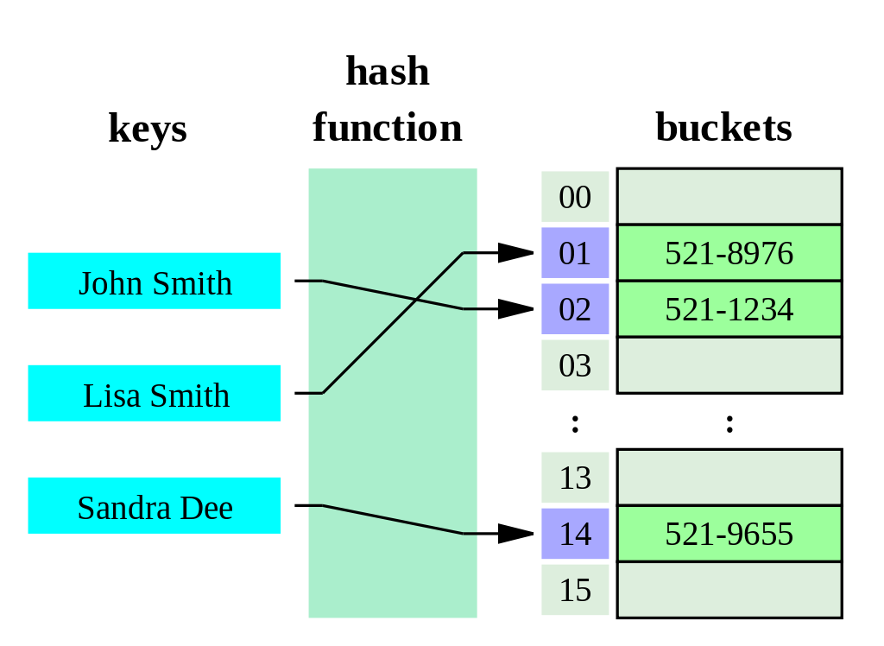
Hash Table
Source https://en.wikipedia.org/wiki/Distributed_hash_table

Slide 3
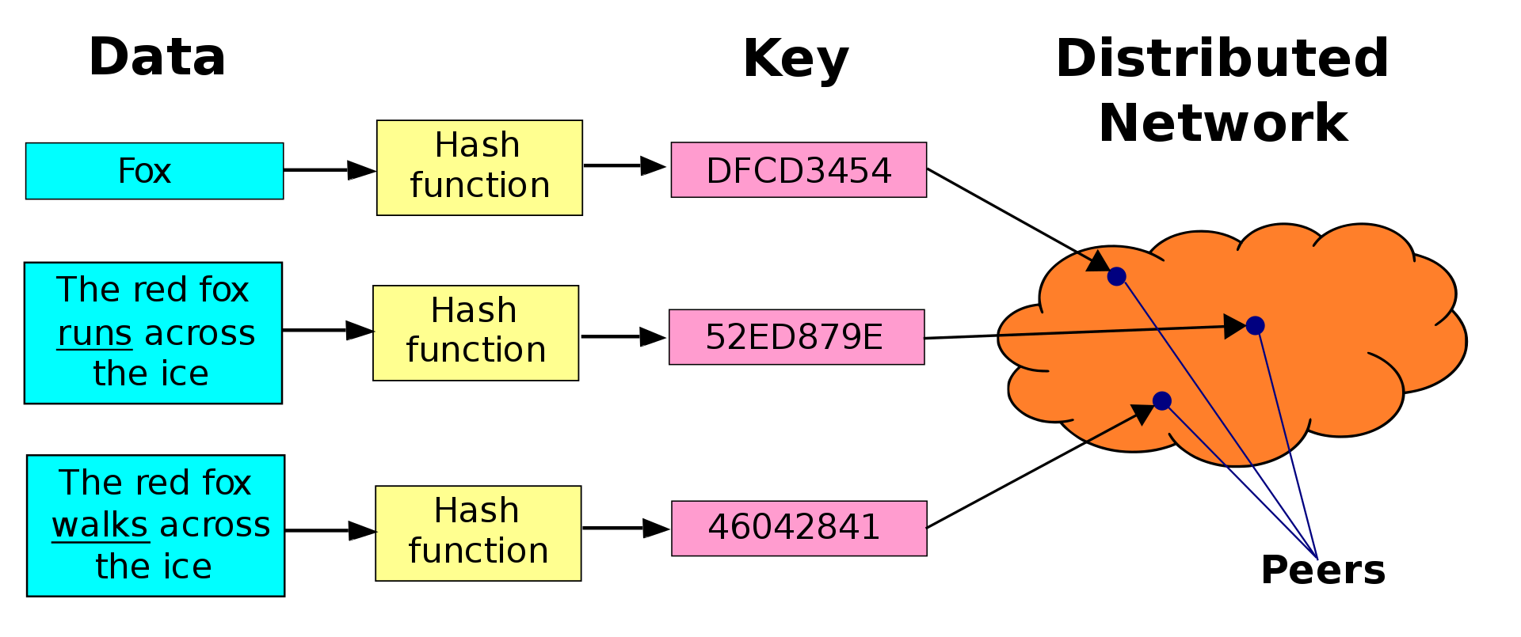
Distributed Hash Table
Source https://en.wikipedia.org/wiki/Distributed_hash_table

Slide 4
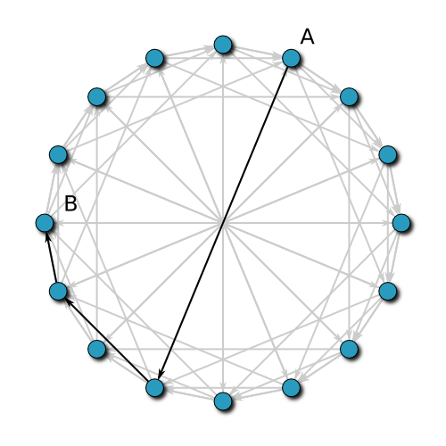
Chord Overview
A peer-to-peer distributed hash table.
Developed by Ion Stoica, Robert Morris, David Karger, Kaashoek, and Hari Balakrishnan from MIT
Keys and IP addresses are hashed into a uniform identifier space (typically using SHA-1)
The keys of the distributed hash table are stored on their closest successor node.
Forms a logical ring with “finger tables” to reduce access time
Source: https://en.wikipedia.org/wiki/Chord_(peer-to-peer)

Slide 5
System Architecture
Chord-based User Service
Monitoring UI
Web Server and Crawler
User Service Node
User Service Node
User Service Node
User Service Node
User Service Node
Admin
User Service Node
User Service Node
User Service Node
Data API Client
User Service Node
User Service Node
Node
Insert, Edit, Remove, Lookup User
User Web App
End User

Slide 6

Chord Node Architecture
Node
CryptoThread
-SHA1
Utils
UserService
-insertUser
-removeUser
-lookupUser
-serve
ChordNode
-initFingerTable
-findSuccessor
-findPredecessor
-stabilize
-join
etc
Node
gRPC
extends
Node

Slide 7
Demo
Using Data API
Large cluster

Slide 8
Agenda
Methodology
“Scrum Light” (with a bit of XP)
Git and GitHub
Mob / Pair Programming via Visual Studio Code “Live Share”
Software Components
VS Code
Node.js, our “least common denominator” language
gRPC, a modern and popular RPC framework
Docker
Azure Container Instances
Architecture
Future Tasks
Demo

Slide 9
Methodology: “Scrum light” (with a bit of XP)
Kickoff meeting to fill out the backlog, using GitHub issues
Kanban board, using GitHub Projects, to track progress
“Asynchronous Standup” on Slack answering the following:
What did you do yesterday?
What are you doing today?
Do you have any blockers?
We using both pair programming and mob programming
One person is the “driver.” One or more people are the “navigators.”
GitHub Flow
Work done in features branches.
Mandatory Reviews via GitHub Pull Requests before merging to master

Slide 10
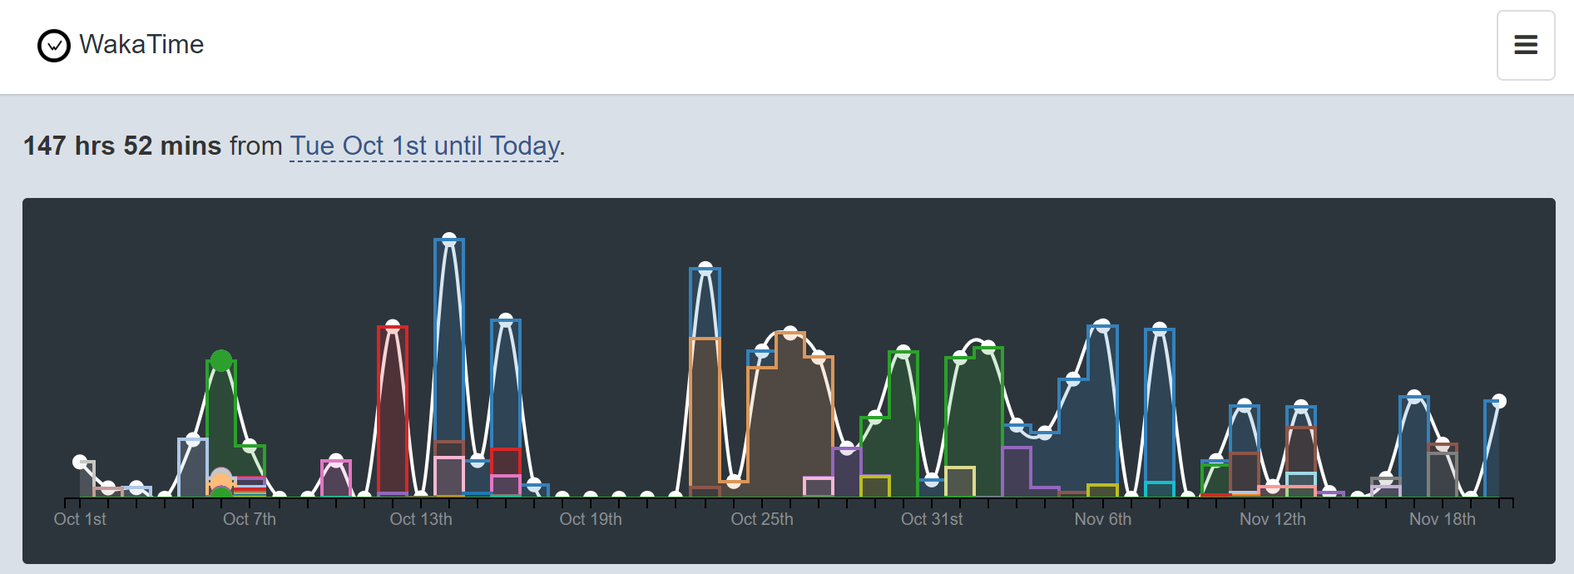
Problems
Agile assumes that everyone is working on the same thing at the same time
Academic Semesters are “event-driven” and bursty, as below
We have different classes, so our bursts often don’t overlap
Because it is hard to quick Pull Requests reviewed quickly, this increases the temptation to have lump unrelated work together

Slide 11
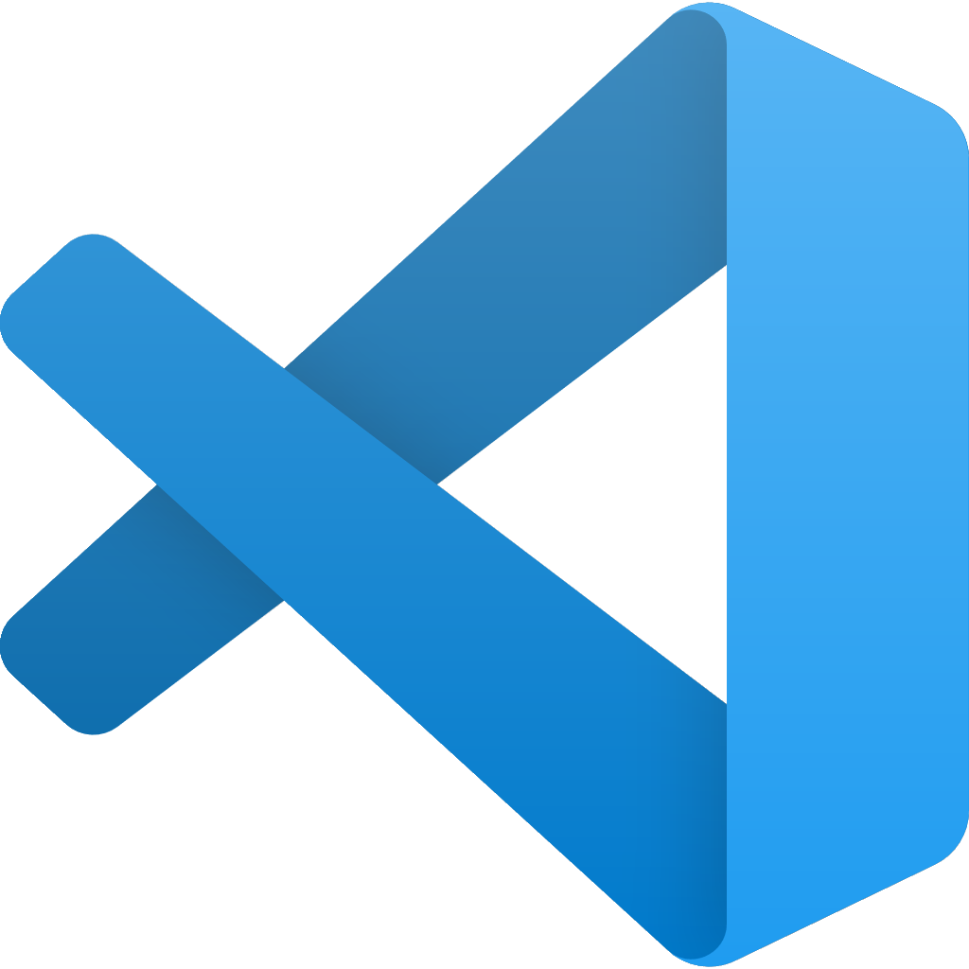
VS Code
Shared configuration and extensions, checked into the git repo
Integrated Pair Programming Tooling
Interactive Debugger
Made it way easier to get started on the project
If we were to do this over again, we’d try to get the interactive debugger setup WAY SOONER

Slide 12

gRPC
Language-agnostic RPC framework with support for most languages.
Real world and popular in most Kubernetes / microservices environments
Our end result is good! Method calls in a try/catch block.
Challenges
Had to learn new Protobuf Syntax
Struggled with asynchronous versus synchronous APIs
Not obvious how to make clean looking Node.js with gRPC API. Documentation site did not use modern syntax

Slide 13
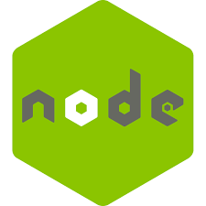
Node.js
Provided the easiest onramp to gRPC. We could dynamically load protobufs rather than doing AOT compilation
Álvaro prefers C#, I prefer Rust, Naim prefers Go, Tyler prefers Python. We picked Node.js as the “least common denominator” language. It looks like C, but is high level and multi-paradigm
Advantages:
gRPC WAS WAY EASIER!!!
Isomorphic: Use the same language for client and server
Good 3rd Party Module Ecosystem. We were able to swap out gRPC libraries.
Disadvantages
Not a close to pseudocode as Python, a more elegant language
Math operators worked a bit differently than expected
More debugging because of loose types

Slide 14

Docker
One command to start a 25-node cluster!
docker-compose up --scale node_secondary=24 -d
Use Case
Lightweight Containers run our components
Docker Compose defines network and how to scale horizontally
Challenges
Docker for Windows required Windows 10 Professional, but Álvaro and Tyler only have Windows 10 Home
Docker works slightly differently between Windows and Linux

Slide 15

Azure Container Instances
Managed Service for running containerized distributed systems
Compared to AWS Fargate, much simpler!
Challenges:
Had to learn new deployment script because it can’t use Docker Compose files

